Slide 1

Job Salary Prediction Using Machine Learning
Technology
Python
Machine Learning
Scikit-learn
NAME :- Vaishnavi Goyal

Slide 2

INTRODUCTION
Salary prediction estimates employee salary automatically.
Salary depends on job role, experience, education, skills, industry, and location.
Manual estimation is time-consuming and less accurate.
Machine Learning improves prediction accuracy.
Gradient Boosting Regressor is used for salary prediction.
The system predicts salary based on user inputs.
Supports better career and salary decisions.

Slide 3

Problem Statement
Manual salary estimation may be inaccurate.
Salary depends on multiple factors.
Traditional methods are time-consuming.
Need for faster and reliable prediction methods.
Machine Learning helps identify salary patterns.
Smart systems improve salary prediction accuracy.
Supports better recruitment and career decisions.

Slide 4
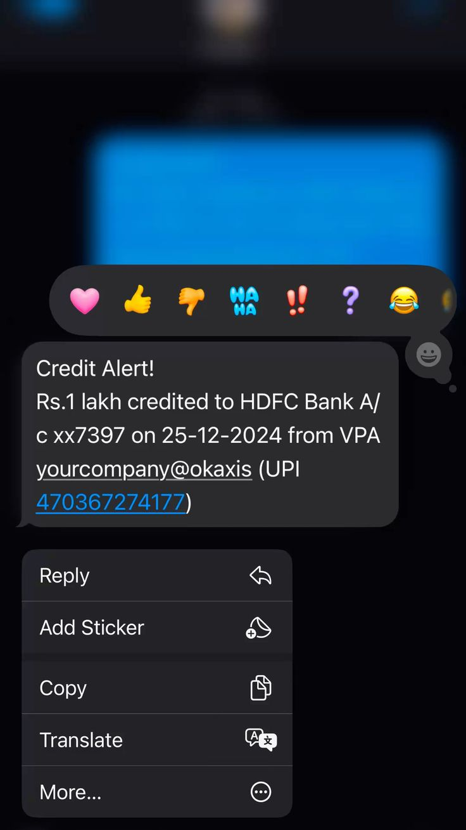
Objective
Build a Machine Learning based Salary Prediction System.
Train the model using historical salary data.
Predict salary based on user inputs and profile details.
Improve prediction accuracy and reliability.
Reduce manual effort and estimation errors.
Support better career and recruitment decisions.

Slide 5
Technologies Used
Python
Core programming language used for developing the Salary Prediction Model.
Pandas
Used for data cleaning, preprocessing, and handling datasets.
NumPy
Supports numerical computations and array operations.
Scikit-learn
Used for building, training, and evaluating Machine Learning models.
Matplotlib
Creates charts and visualizations for data analysis.
Visual Studio Code (VS Code)
Code editor used for writing, debugging, and managing the project efficiently.

Slide 6

Dataset Description
Dataset File :
data.csv
Target Variable :
Salary
Features :
Job Title
Experience Years
Education Level
Skills Count
Industry
Company Size
Location
Remote Work
Certifications

